Slide 1
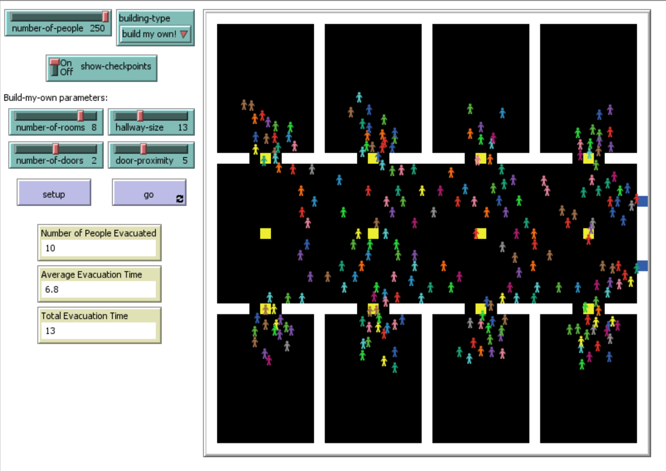
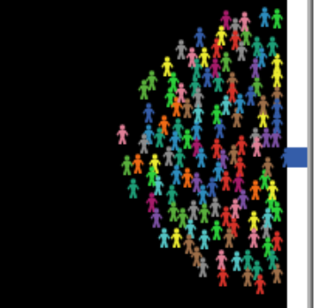
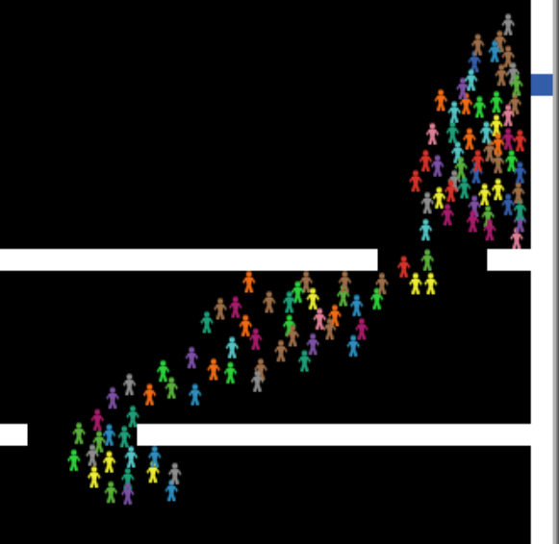
Emergency Evacuation
Spring 2018 EECS 372
Multi-Agent Modeling
Professor Uri Wilensky
Eric Hao
Motivation
It impacts real lives during emergencies
Agent-Based Modeling (ABM) can be applied naturally and intuitively
Applications extend beyond emergency readiness, including computer vision and swarm intelligence
Sensitivity Analysis
Three parameters were tested against number of people
Door proximity (how close together exits are)
Hallway width
Number of rooms
Results
Having exits very close together increases evacuation time, because the crowds around two exits merge into an even larger one. Exits far apart are bad, too, because redistribution between exits takes longer. Larger hallways are better when there are not that many people (over 100), but it either doesn’t matter or might even be slightly worse when there are lots of people (under 100). In general, more rooms are better, except when there are fewer (50) people in the room.
How It Works
At each tick, each person selects a target
Select a visible exit. If there are none, then
Select a visible checkpoint. If there are none, then,
Select a nearby visible spot
Selection is based on five heuristics
The Five Heuristics
Crowdedness: How crowded is it?
Wall proximity: How many walls are near it?
Distance from me: How far away is it from me?
Distance from exits: How far away is it from exits?
Crowd heading: Is the crowd heading toward or away from it?
Emergent Behaviors
People clog around exits, forming a circular crowd around the exit:
People who cannot see exits or do not know where exits are try to follow the direction of the crowd, creating a herding or flocking behavior:
Heuristic Selection
Heuristic selection is handled differently when choosing different types of targets (exits, checkpoints, or regular patches). This is because the desirability of the heuristics varies depending on what type my target is. For example, if I am picking an exit, crowdedness is bad. However, if I don’t see any exits, then crowdedness is good.

